Slide 1
BRMS in Business Digital Transformation
Stelios Kousouris
EMEA Applications Architect
Automation & Big Data Practice Lead
Big Data Community of Practice Manager
May 2017

Slide 2
Who Am I?
Stelios Kousouris
Applications Architect @ Red Hat Consulting Services
EMEA Architect Team
JBoss Middleware
App Dev (EAP, Wildfly Swarm)
Business Automation (BRMS, BPMS)
Big & Real-Time Data Analysis and Process (Data Grid, Data Virtualization)
Hampshire, United Kingdom
<number>
BRMS in Digital Transformation

Slide 3
AGENDA
Business Rules
Introduction JBoss BRMS Features
BRMS Demo Story
Real BRMS Use Cases
Conclusion
<number>
BRMS in Digital Transformation

Slide 4
Digital Transformation Goals & Challenges
Notes:
We need to envision the opportunities of using BRMS within the context of Digital Transformation. It is an enterprise’s endeavour to achieve
Greater connectivity
Self and Customer awareness
Achieve larger market monetization
Efficient and cost-effectiveness
Which dictate the need for digital transformation. BRMS is in that front tool to assist gaining not only digital connectivity but also digital awareness.

Slide 5



Goals of a Modern Enterprise
Engage Customers in new ways
Develop more applications faster
Be more customer centric
<number>
BRMS in Digital Transformation
Notes:
We need to envision the opportunities of using BRMS within the context of Digital Transformation. It is an enterprise’s endeavour to achieve
Greater connectivity
Self and Customer awareness
Achieve larger market monetization
Efficient and cost-effectiveness
Which dictate the need for digital transformation. BRMS is in that front tool to assist gaining not only digital connectivity but also digital awareness.

Slide 6



Enabling Digital Transformation
Digital Automation
Automate
Enable
Orchestrate
Between systems of engagement and systems of record.
Collaboration between knowledge workers.
Manual Tasks
Decisions
Intelligence
Business users to develop applications (low-code app-dev)
<number>
BRMS in Digital Transformation
Notes:
One of the characteristics of a modern app is “Intelligence”. Example
Personalized offers based on preference (e.g. recommendation engine. We know who you are, we’ve built a profile, and based on that profile and your current activity, we make personalized recommendations and offers).
Bank automatically notifies customer and security agencies if it detects fraudulent transactions on a card (CEP for detection, BPM for the process to be started).
At an airport, baggage handling events are processed by a BRMS engine to detect whether a certain bag is actually on board or not. When a bag is not on someone’s plain, the customer is directly notified with the instruction on which office to contact at the destination airport (including a map and location).

Slide 7

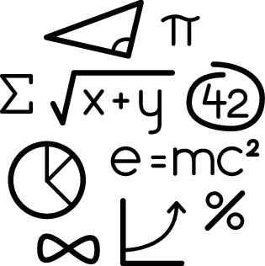
Challenges
Some of them ...
Application Time-to-Market too long
Mobile Apps are built separately
Developers don’t understand business needs
<number>
BRMS in Digital Transformation
Notes:
Traditionally, application development teams had and still have a different TTM than business delivery teams. There are good reasons behind this as software lifecycle and industry best practices focus on the stability of the software and far less on the agility of the releases to coincide with the business needs.
In addition, the application landscape within an enterprise may not be as homogenous as one would expect with different needs catered by separate applications each maintaining a separate business strategy “understanding” resulting in a brittle business strategy application and maintenance nightmare in the absence of business logic federation.
Furthermore, prior to even getting to the stage of having business logic implemented in applications the biggest challenge the business team faces is communicating the required logic to the technical teams. A big chunk of application implementation time is spent in functional tasks and ensuring the expected business logic has been achieved is not
Always a priority
Difficult to measure

Slide 8
Introduction to Business Rules

Slide 9




Rules
Rules are all arounds in nature and everyday life
Laws, Regulations and Policies
Biological Rules
Determine Pricing of Products and Services
<number>
BRMS in Digital Transformation
Notes:
Our everyday life is driven by rules. Every time we stop at a red light while driving, we do so as we're following a rule that says we should stop when the light turns red. We all also know the rule that states that when we are of a specific age, we are allowed to take a test to get a driving license.
Even if we don't follow these rules, we're still bound by the rules of nature; if you don't breathe in oxygen, you asphyxiate. If you jump, you're going to touch the ground eventually as the rules of physics determine that gravity will pull you down. Some of these rules (like gravity) have been studied so much that they can be expressed as simple mathematical equations.
However, for our everyday rules that we consider common sense, we use a simpler structure: for a group of conditions that we detect, we take specific actions.

Slide 10



Business Rules
Business Rules are in at the heart of every organization
Laws, Regulations and Policies
Drive Process Decisions
Determine Pricing of Products and Services
<number>
BRMS in Digital Transformation
Notes:
These sort of structures are very important for organizations as they have to deal increasingly with complex scenarios.
These scenarios are composed of a large number of individual simple decisions, which work together to provide a complex evaluation of the full picture.
This complex evaluation starts with simple assessments used to determine the nature of our environment that we will call inferences.
These inferences might be crossed with other pieces of data or more inferences until a complex view of the domain can be achieved, understood, and actions can be taken

Slide 11


Challenges to address
Changing Policies and Rules
Developers reported that implementing updates and changes to application logic and business rules were the most difficult tasks for maintaining existing business applications.
FORRESTER RESEARCH 2014
Increasing Events from various sources
In business today, enterprises use CEP as core technology to describe and monitor complex patterns, identifying when they take the functional equivalent of a wrong turn.
IDC
Processes
To succeed, CIOs and their business partners will need to innovate — figuring out how they can change products, processes, go-to market strategies, and their organizational structures — to meet the changing needs of their customers in a rapidly evolving marketplace.
FORRESTER RESEARCH 2014
<number>
BRMS in Digital Transformation
Notes:
The challenges we can address by defining our business rules is to allow our organization
Flexibility over application logic
Agility to react changing events
Ability to Innovate

Slide 12
Why do we use rules?
Complexity justified by projects which
They're independent
They can be easily updated
Each rule controls minimal amount of information needed
They allow more people of different backgrounds to collaborate
<number>
BRMS in Digital Transformation
Notes:
Why do we use rules?
At this point, you might be still a bit puzzled about why rules are something useful. If we think of it, in terms of one rule or a few, we might consider it better to do it directly on the imperative code like Java, for example.
However, the main strength behind business rules doesn't come from one rule or a small group of rules, it comes from a large, ever-changing group of rules that define a system so complex that it would require extensive work to maintain it if we did it with regular code.
Many rules can work together to define complex systems as the growth of the business rules code base happens organically.
Whether we need to implement new requirements, modify existing ones, replace parameters, or change the structure of our system behaviour in new unexpected ways, the only thing we will need to do with the rules is implement new rules that now apply and remove the ones that don't apply anymore. This is possible as business rules work on the following principles:
• They're independent
• They can be easily updated
• Each rule controls minimal amount of information needed
• They allow more people of different backgrounds to collaborate

Slide 13
When should we use rules
Complexity justified by projects which
Define a very complex scenario that is difficult to fully define even for business experts
Do not have a known or well-defined algorithmic solution
Have volatile requirements and need to be updated very often
Need to make decisions fast, usually based on partial amounts of data correlating and aggregating events
<number>
BRMS in Digital Transformation
Notes:
When should we use rules?
Nonetheless there are some projects that would benefit the most on introducing business rules to their technological stack. These projects have one or more of the following characteristics:
• They define a very complex scenario that is difficult to fully define even for business experts
• They don't have a known or well-defined algorithmic solution
• They have volatile requirements and need to be updated very often
• They need to make decisions fast, usually based on partial amounts of data

Slide 14
BRMS Suite Value across industries
Banking
Insurance
Capital Markets
Public Sector
Loan Organisation
Credit Decisioning
Sales Advisory
Payments
Accounting
Claims Processing
Underwriting
Quoting
Rating
Commissioning
Automated Trading
Trade Order Mgmt
Accounting
Compliance KYC/AML
On Boarding
Claims Processing
Entitlement Calc.
Benefit Calc.
Fraud Detection
Screening
Telecom
Transportation
Retail
Manufacturing
Offer Configuration
Order Mgmt
Fraud Detection
Loyalty Programs
Network Monitoring
Promotions Mgmt
Loyalty Programs
Customer Service
Billing
Contract Mgmt
Recommendation
Campaign Mgmt
Order Mgmt
Pricing
Order Mgmt
Billing
Contract Mgmt
<number>
BRMS in Digital Transformation

Slide 15
Introduction to JBoss BRMS

Slide 16







Red Hat JBoss Automation Products
RED HAT JBOSS
BxMS SUITE
Business
Process
Management
Business
Resource
Planning
Business
Rules
Management
Complex
Event
Processing
Red Hat JBoss BRMS
ON-PREMISE
PRIVATE
PUBLIC
<number>
BRMS in Digital Transformation

Slide 17

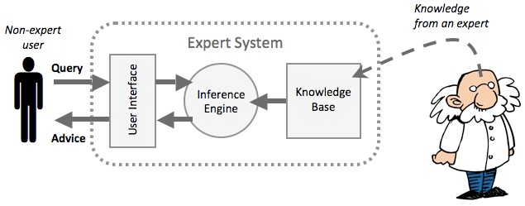
Some history and highlights
JBoss BRMS is an OpenSource product supported by Red Hat:
Community project name: DROOLS (added to Red Hat family in 2006)
Roots in artificial intelligence
that include Expert Systems,
known as Knowledge based
Systems
Expert System:
“A piece of software programmed using artificial intelligence techniques. Such systems use databases of expert knowledge to offer advice or make decisions in such areas as medical diagnosis and trading on the stock exchange.”
Drools uses RETE algorithm discovered by Charles Forgy and published in 1982 and since 2014 the PHREAK algorithm speeding up reasoning by avg 25%.
Image credit: http://www.igcseict.info
<number>
BRMS in Digital Transformation
Notes:
In artificial intelligence, an expert system is a computer system that emulates the decision-making ability of a human expert. They are designed to solve complex problems by reasoning about knowledge, represented mainly as if–then rules rather than through conventional procedural code. The first expert systems were created in the 1970s and then proliferated in the 1980s.Expert systems were among the first truly successful forms of artificial intelligence (AI) software.
An expert system is divided into two subsystems: the inference engine and the knowledge base.
The knowledge base represents facts and rules.
The inference engine applies the rules to the known facts to deduce new facts.

Slide 18

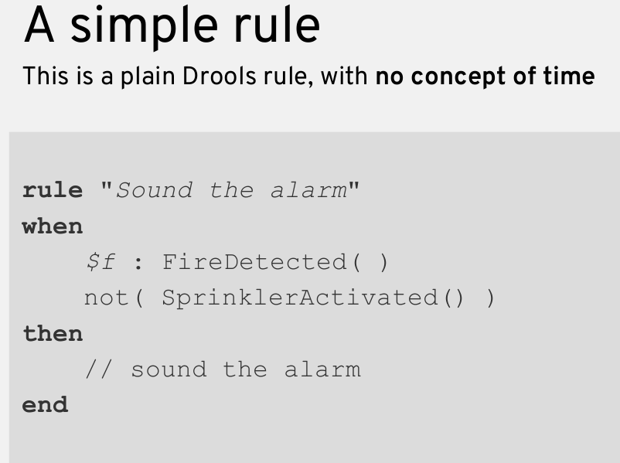
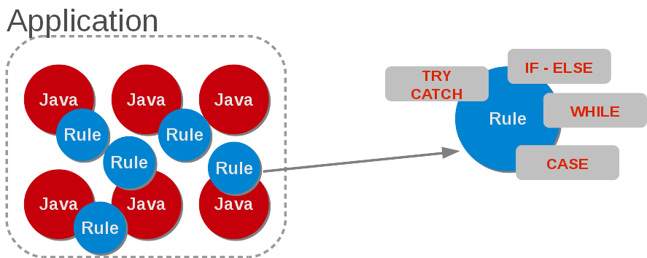
What is a rule?
Concepts
Rule engines allow you to say "What to do" depending on a context (Facts), not "How to do it".
Usually captured in natural language first
Rules are expressed this way:
IF <CONDITIONS> THEN <ACTIONS>
Well suited to describe any kind of logic
<number>
BRMS in Digital Transformation
Notes:
Rule engines allow you to say "What to do" depending on a context (Facts), not "How to do it".
Usually captured in natural language first
Rules are expressed this way:
IF <CONDITIONS> THEN <ACTIONS>
Well suited to describe any kind of logic

Slide 19

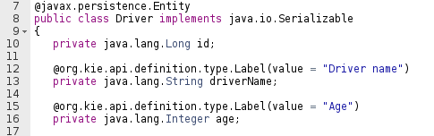

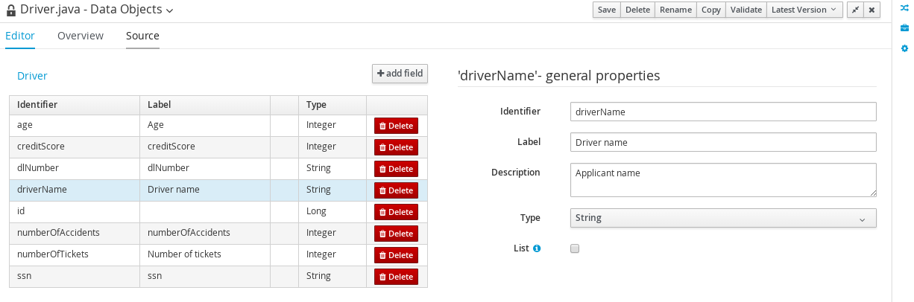
Fact Model
Concepts
Programming Model
Representation of entities of a domain
Entities are modeled in Java with classes and attributes
Analogy with Java: Fact Model is for a class as well as Fact is for an object
For instance a fact is: a Driver of 22 years, with monthly income in 1000, and married status
Driver
Declarative Model
<number>
BRMS in Digital Transformation
Notes:
Representation of entities of a domain
Entities are modeled in Java with classes and attributes
Analogy with Java: Fact Model is for a class as well as Fact is for an object
For instance a fact is: a Driver of 22 years, with monthly income in 1000, and married status

Slide 20
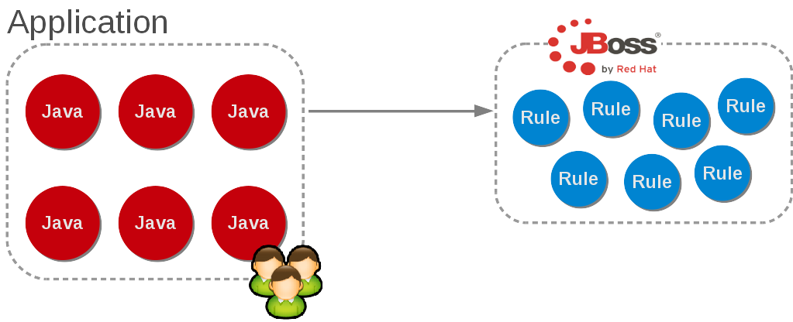
Rules Engine
Concepts
A rule engine is a software component that processes rules (knowledge) against data (facts) -> It matches facts with rules
BRMS provides following benefits:
Logic and Data Separation
Reusable
Centralized
Declarative
Speed and scalability
Tooling for analysis
<number>
BRMS in Digital Transformation
Notes:
A rule engine is a software component that processes rules (knowledge) against data (facts) -> It matches facts with rules
BRMS provides following benefits:
Logic and Data Separation
Reusable
Centralized
Declarative
Speed and scalability
Tooling for analysis

Slide 21
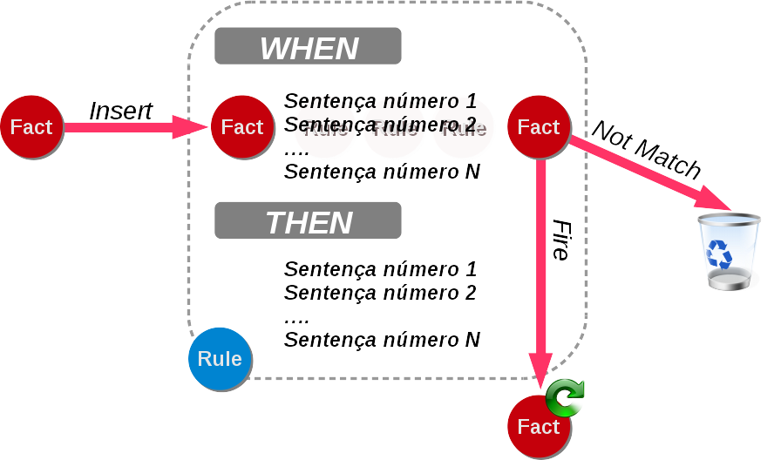
Rules Engine
Concepts
BRMS rule engine uses Forward chaining
It means that rules are fired when conditions are met
It uses multiples rules at the same time with multiples facts
It is fast and scalable
Features inference (re-evaluation)
<number>
BRMS in Digital Transformation
Notes:
Here we can see some characteristics of the Rules Engine.
The most important ones to go away with are
It reasons over multiple rules and facts at the same time. Unlike code is does not do so in a sequential manner. Despite that it is extremely fast due to the way to it combines and reasons over conditions for multiple rules in single step.
It not only relies on inserted by the environment context it can infer you facts expanding the intelligence of the system

Slide 22






BRMS Suite not just a Rules Engine
Red Hat JBoss BRMS Architecture
Delivery compatible with industry best practices
Operations
Authoring Environment
Runtime Environment
Web Services
Rules
Developers
Business Central
Intelligent Decision Execution
Entreprise Applications
...
Business Analysts
<number>
BRMS in Digital Transformation
Notes:
The high-level architecture of JBoss BRMS Suite is:
Top left: the design and authoring environment: Business Central. Technology based on Uberfire, Errai, Git and Maven
Top middle: The runtime engine: Intelligent Decision Server for BPM Suite (jBPM), Decision Server. (which can run Planner as well).
Integration with external systems on the right.
The data that comes out of the process automation (listeners on the process runtime into the BAM database). This data can then used to improve the process in the design-time environment.

Slide 23










Red Hat JBoss BRMS Suite Architecture
Why JBoss BRMS much more than just a Rules Engine
Business Central
Tools for business experts
Mobile Apps
APPS
APPS
APPS
Web Services
RULES
Decision Services
Enterprise Apps
Tools for developers
Embedded Java
Client-Server/Embedded
delivered Intelligence
IDE Plugin
<number>
BRMS in Digital Transformation

Slide 24

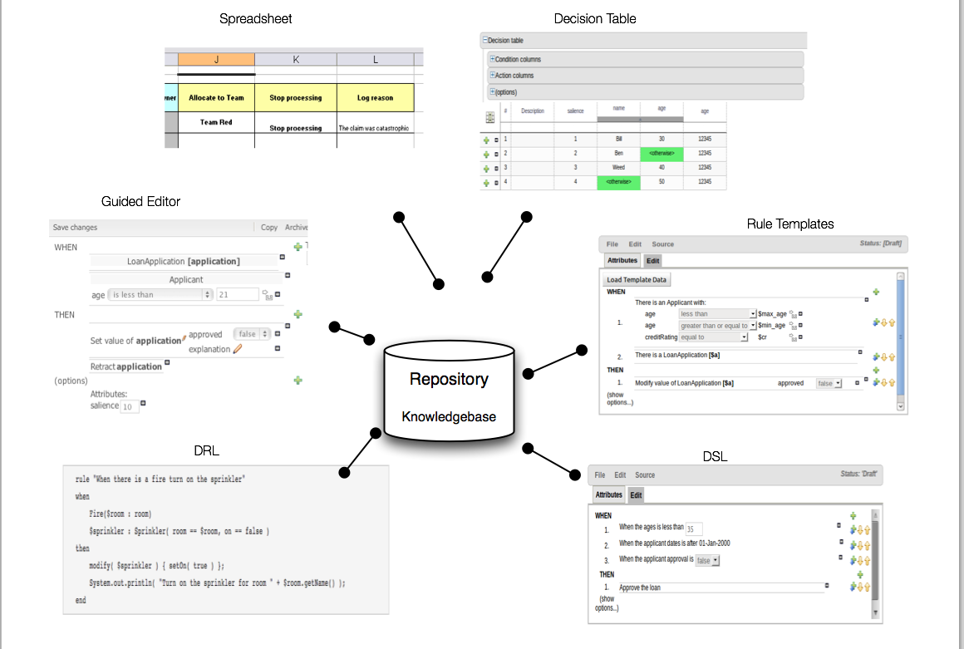
Business Rules Authoring
Rule authoring choices
BRMS specific language (DRL)
Guided Editor
Decision Tables (Guided Editor)
Decision Tables (Spreadsheet)
Domain Specific Language (DSL)
<number>
BRMS in Digital Transformation

Slide 25
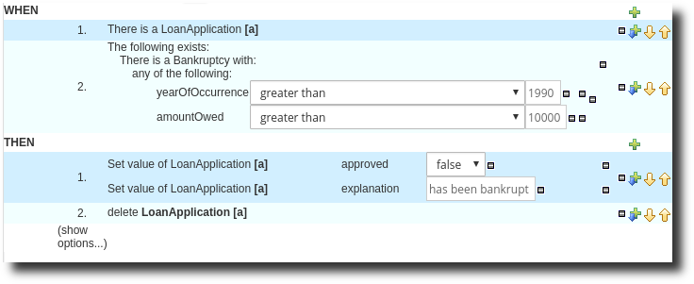
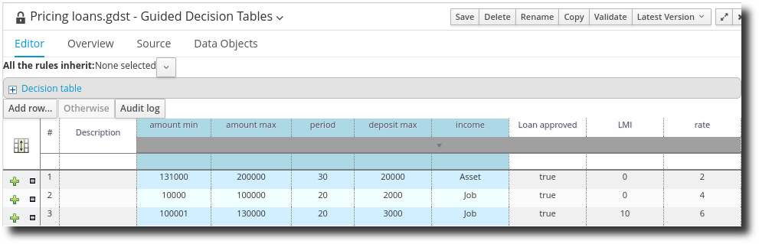
Business Rules Authoring
Business Analyst authoring choices
Rules
Template
Decision Table
Score Cards
Guided Decision Trees
Excel
<number>
BRMS in Digital Transformation

Slide 26
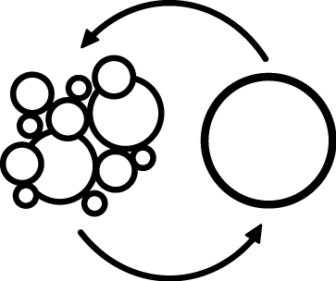
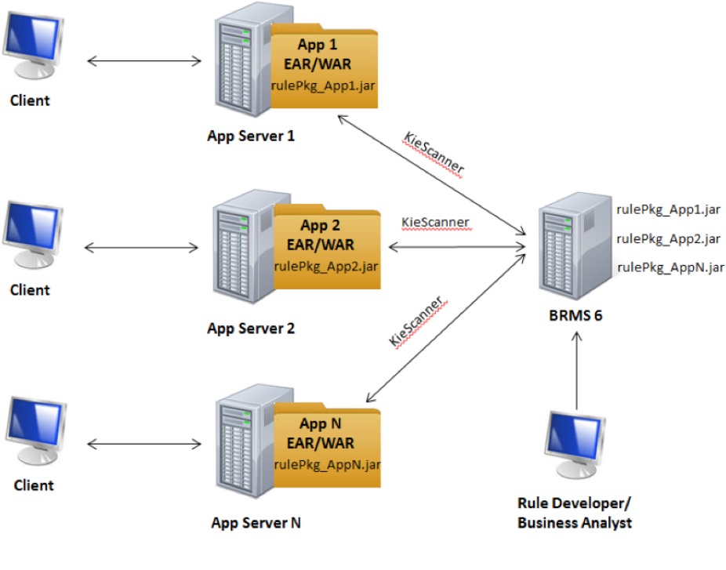
Business Runtime Architecture
Embedded
Embedded the rule project within your application BUT NOT The Rule Artifacts
Rule administrator builds a rule project, this is also downloadable as jar file.
Application is made aware of Rules downloadable
KieScanner will pick it up on the configured interval and load the new version into the Client application.
Included into the Client app.
PROS: SPEED SPEED SPEED
Bring your Rule to your data not the other way around
<number>
BRMS in Digital Transformation
Notes:
Embedded the rule project within your application BUT NOT The Rule Artifacts
Rule administrator builds a rule project, this is also downloadable as jar file.
Application is made aware of Rules downloadable
KieScanner will pick it up on the configured interval and load the new version into the Client application.
Included into the Client app.
PROS: SPEED SPEED SPEED
Bring your Rule to your data not the other way around

Slide 27

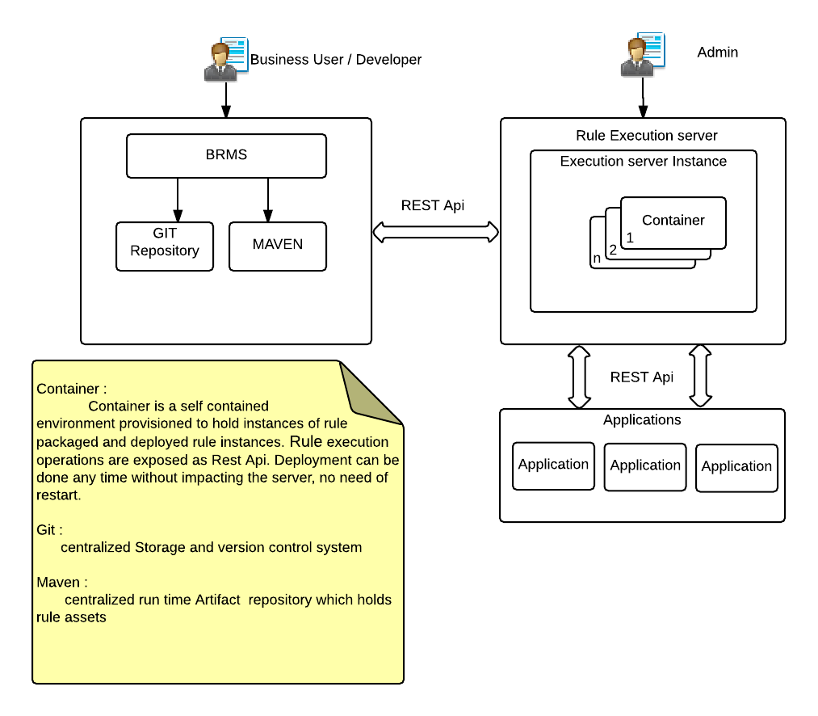
Business Runtime Architecture
Real-Time Decision Server
Provides an unified platform to execute Rules
Rules can then be instantiated and executed through REST, JMS, or Java interfaces.
The real time decision server manages containers that can run independently of each other.
A rule administrator can create a container and select a rule project that will run in that container.
<number>
BRMS in Digital Transformation
Notes:
Provides an unified platform to execute Rules
Rules can then be instantiated and executed through REST, JMS, or Java interfaces.
The real time decision server manages containers that can run independently of each other.
A rule administrator can create a container and select a rule project that will run in that container.

Slide 28
Complex Event Processing

Slide 29
What is CEP?
Some definitions
What is an Event?
A significant change of state at a particular point in time.
What is Complex Event Processing
The ability to detect, correlate, abstract, aggregate or compose and react to events.
<number>

Slide 30

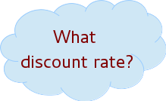




Reasoning over still facts
Drools Expert
WHEN the Total purchases of Account > $2,500
THEN the enterprise value of Customer is GOLD
WHEN the enterprise value of Customer is GOLD
THEN the discount rate is 15%
(...)
Synchronous behavior
<number>

Slide 31
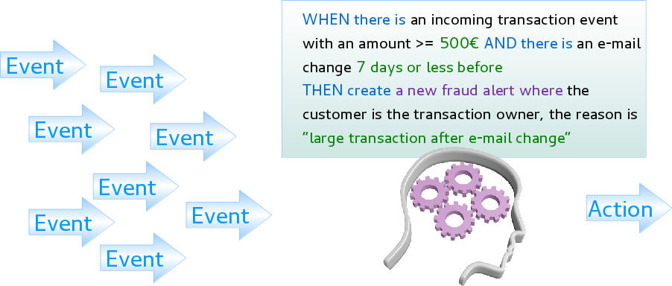
Reasoning over streams of facts
Drools Fusion
Reasoning over streams of events
An event is a significant change of state at a particular point in time
Examples in Insurance vertical
Fraud detection
Risk assessment
BAM
Pricing
Rating
Asynchronous behavior
<number>
Notes:
Many use cases which require us to review facts not only in a single point in time BUT over a period of time whilst the event takes place and to correlate it with other events also happening.
Examples in Insurance vertical
Fraud detection
Risk assessment
BAM
Pricing
Rating

Slide 32
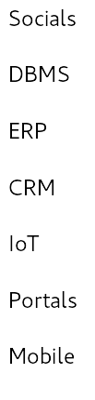


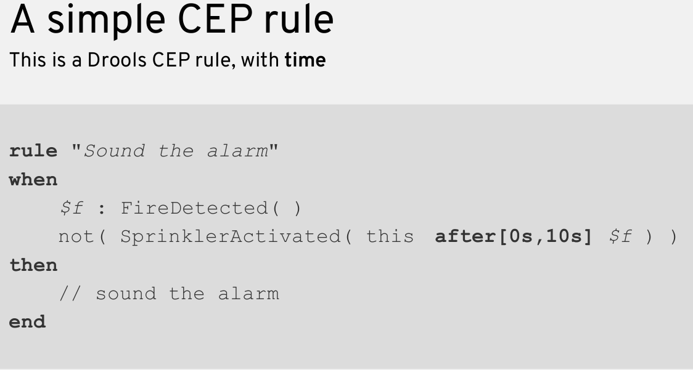











Accurate Decisions in Timely Fashion
Non-Static Data or Decisions
<number>
Notes:
Synergies with Statistic Science

Slide 33
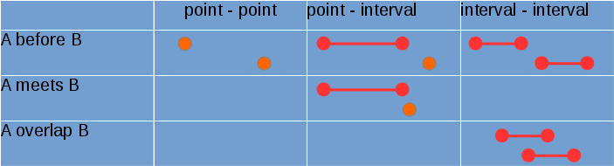
Reasoning over Time: Temporal Operators
Detect, correlate, abstract, aggregate or compose and react to events
Strong temporal relationships between events
Allow for detection, correlation, aggregation and composition
Temporal Constraint operators express relationship between events
Operators are Supported: after, coincides, during, met by, finishes, finished by, includes, overlapped by, starts, started by.
<number>
Notes:
Synergies with Statistic Science

Slide 34
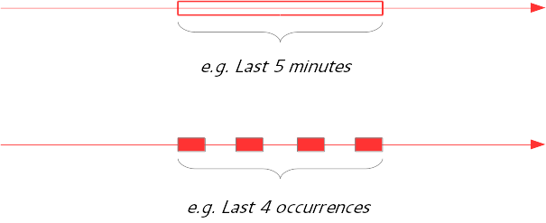
Reasoning over Time: Sliding Windows
Sliding Time Window
rule "Average Order Value over 12 hours"
when
c : Customer()
a : Number() from accumulate (
BuyOrder( customer == c, p : price )
over window:time( 12h ),average( p ) )
then
// do something
Sliding Length Window
rule "Average price of the last three recorded trades"
when
avgPrice: Number( ) from accumulate(
StockTrade( ticker == "RHT", p: price )
over window:length(3), average( p ) )
then
// do something
<number>
Notes:
Synergies with Statistic Science

Slide 35
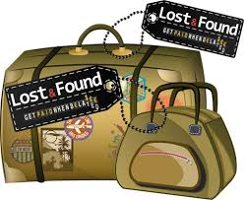
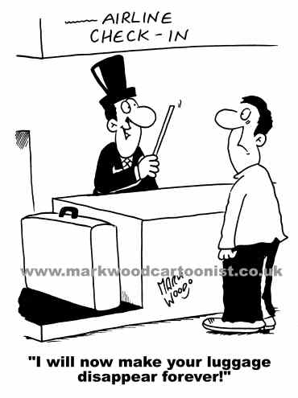











Detecting Luggage Airport Processing
Alert raised
Passport No.
Bag Tag ID
30 minutes after check-in
Bag Tag ID
Airline informed
Bag Tag ID
< 1 min & > 50 bags
Activate more conveyor belts and/or increase handling staff
20 minutes b4 flight not through passport control
Passport No.
announcement
Gate no show
Bag Tag ID
Remove luggage
Passport No.
inform
> 2 hours increase airport staff
<number>
Notes:
rule "Average Order Value over 12 hours"
when
c : Customer()
a : Number() from accumulate (BuyOrder( customer == c, p : price ) over window:time( 12h ),average( p ) )
then
// do something
rule "Average price of the last three recorded trades"
when
avgPrice: Number( ) from accumulate(StockTrade( ticker == "RHT", p: price )
over window:length(3), average( p ) )
then
// do something

Slide 36
Is CEP the only way for Complex BRMS usage?
Why Not
BRMS Rules are a declarative way to define complex business logic outside of procedural functionality (apps).
Synergies with statistical Science
Apply accelerated and efficient analysis of datasets considered as Big Data
<number>
Notes:
Synergies with Statistic Science
BRMS Rules are a declarative way to define complex business logic outside of procedural functionality (apps). → This in its own is extremely complex to achieve in application when partnered with the flexibility it exhibits to change that business logic with minimal/none at all change to surounding functionality.
Synergies with Statistical Science
The branch of mathematics that deals with the collection, organization, analysis, and interpretation of numerical data. Statistics is especially useful in drawing general conclusions about a set of data from a sample of the data. (Used with a plural verb) Numerical data.
Utilized in infering behaviors & patterns in Big Data Processing & Analysis use cases.

Slide 37
Why architecting with Rules?

Slide 38
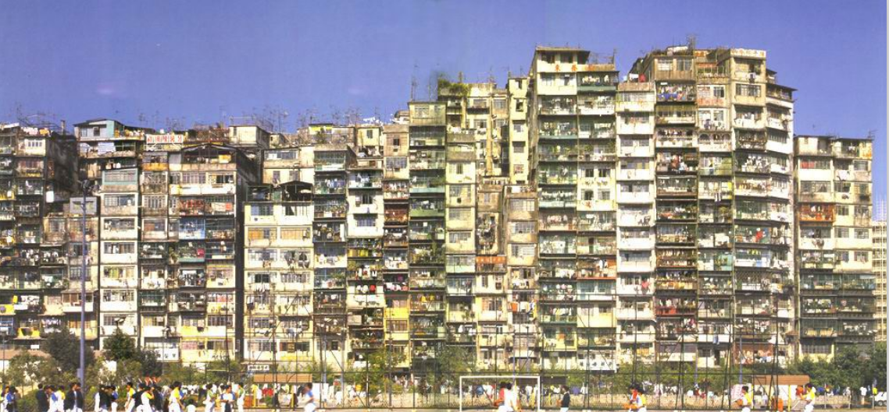
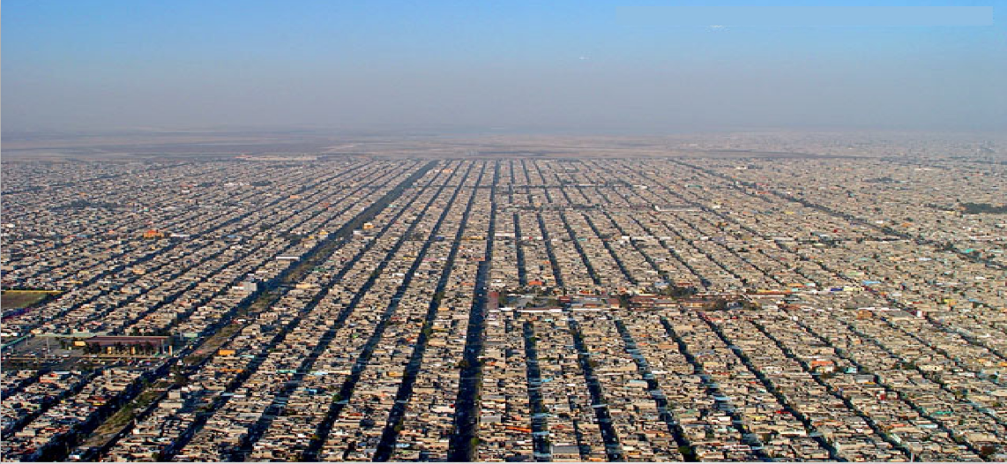
Architecture
Different Types
<number>
BRMS in Digital Transformation
Notes:
Why Architecture matters?
“IT” is a tool for Business, and Business is a “living and evolving organism”.
Business Agility
Small but continuous changes keep occurring. Not a big change, revolution.
Additions and changes in a system happen as business requests them.
IT (business applications) does not catch up with a speed of business progress, and/or requires major costs to do so.
Well, aren't there any problems with application architecture?

Slide 39
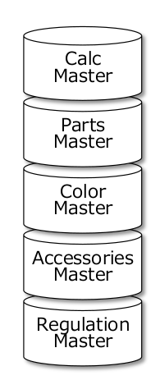
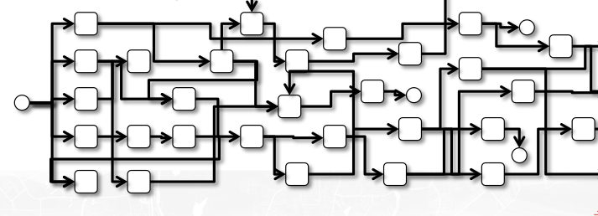
Architecture - What causes bad maintainability?
Process & Data Coupling
Complex data
Persisted Logic
"Status as a combination of data”
Processes should decide status management, not the opposite.
Tightly coupled data and process
Once unexpected data is submitted, the task will be lost.
Complex data diagram, like a jungle.
Processes should be simple.
A lot of branching is made based on the data
If a process is determined by data, then it is a good idea to
use rule engine for handling them and keeping a process itself simple.
A rule named the "Master”
Referring the master DB from a logic.
Unless users maintain the master table well, wrong results can be sent for a long period.
If changes cannot be made or maintained in the master table, then it needs to be described as a program logic.
amount = null and authCode =0 or 99 → START
amount >= 0 and 1stApproval = 8 or 2ndApproval = 8 or 9, and
SKU does not start with “A”, “B”,..., “K” → Required BU approval
<number>
BRMS in Digital Transformation
Notes:
Logic mixed with business process. Hard coded values required for a process to execute business logic.
Project technical debt increases the more we couple tightly the two despite potential early wins by doing so in the long run we end up with spaghetti application code.
Business logic cannot be extracted from the functional components when we move to a new technology stack nor when we implement applications for different streams (mobile, email, online, etc.)
The most important aspect in our processes and business logic is the data.
Complex data coupling addressing multiple business problems
Data which act as business logic
Tight coupling of logic and data
An extension of the above where logic data is persisted with
Slow cycles of updates which are not performed directly by business users
Low transparency

Slide 40
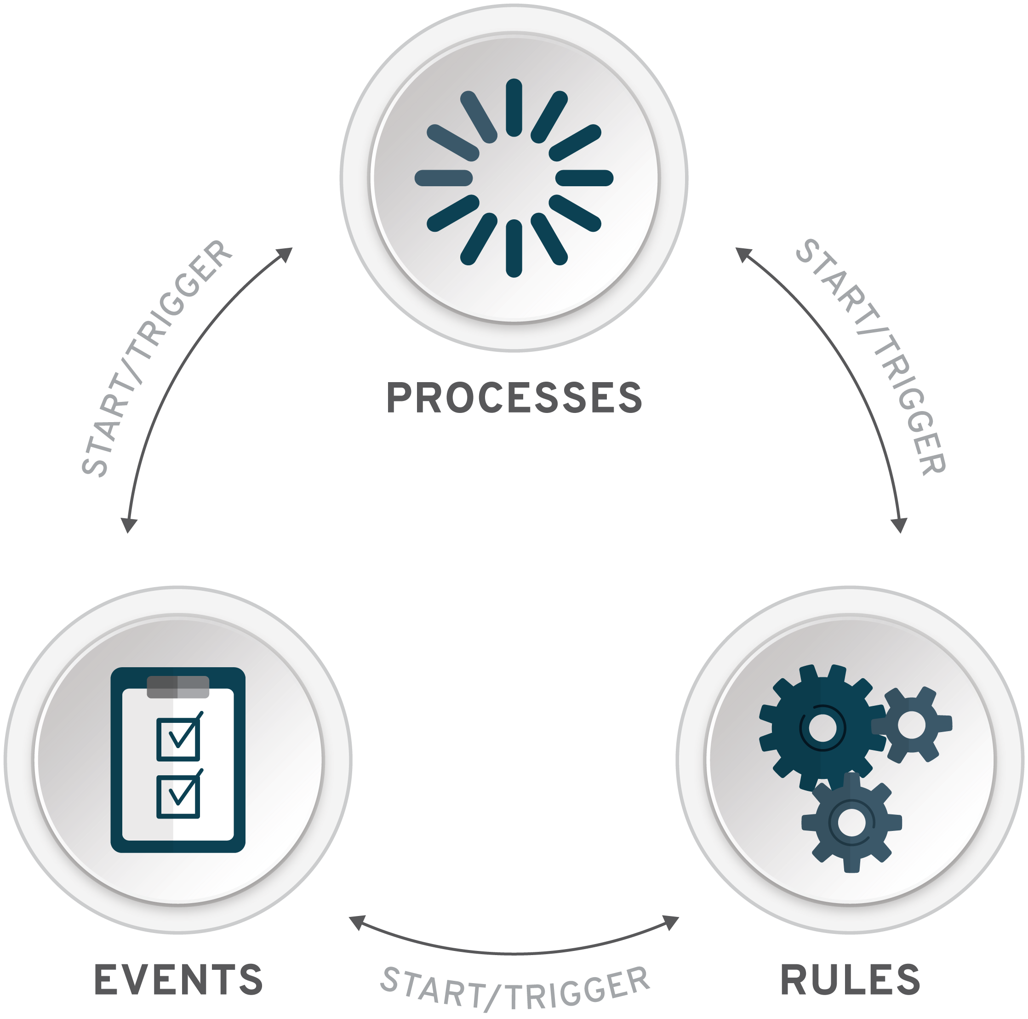



Achieving Separation of Concerns
Are you still mixing logic in your processes?
70-80% of architecture
<number>
BRMS in Digital Transformation
Notes:
Following what we have seen on what reduces maintainability in IT architecture it is our experience that separation of concerns between the 3 main pilars
RULES
PROCESSES
DATA/EVENTS
Should be achieved in any and every project.
This way a common interface can be achieved between Business Rules and Processes driven by the Business Domain and not the technical implementation.
Any changes will be transparent to both ends whilst Business Decisions (Rules) changes can occur without the need for processes and data to be changed.

Slide 41
BRMS In Action
Notes:
In the following demos we will explore through a use case which is very commonly identified in retail stores.
We will be utilizing progressively features of the BRMS platform to identify ways these could resolve Business & Technical problems and understand how otherwise both business and technical teams would feel the pains.
As setting up such Demos requires a significant amount of time and rules are not UI based technology some of the story will be described in presentation style. We therefore would appreciate very much if some imagination of how a real life all singing and dancing applications would in the background utilize these BRMS components exposed with a flashy UI.

Slide 42

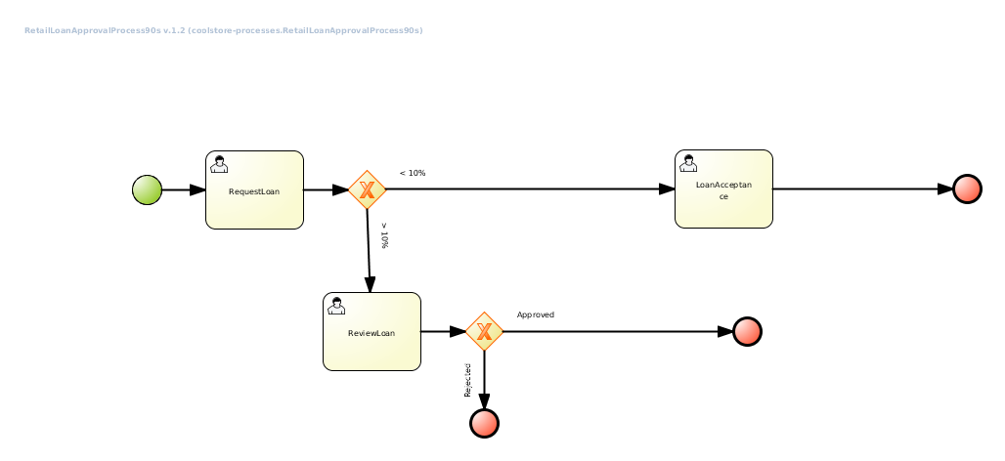


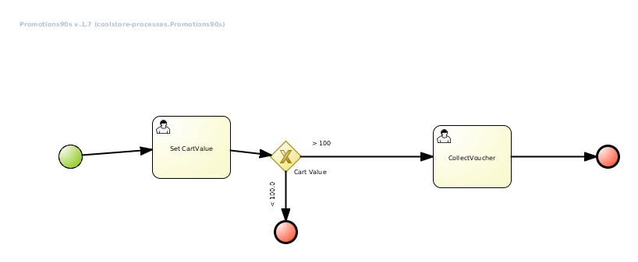
ABC Ltd - Coolstore with Static Logic
Marcketing
www.abc
Customer
DEVELOPER
<number>
BRMS in Digital Transformation
Notes:
Back in the future In 1999 ABC Ltd. have developed a super cool web store which offers online products to customers and in the background it runs 2 processes.
Process Promotions90s: Based on the value of purchases a customers has made ABC Ltd. marketing officer wished to offer them a number of rewards. The rewards can be re-used on our website to make both the customer happy they have received a generous voucher and marketing that see customer retention increase
Process RetailLoanApprovalProcess90s: When a customer doesn’t have enough electronic credit they can apply for a loan through a second process in order to bump up their credit
The problem: Reviewing the processes we notice that the process which in this case is A BPM process but could as easily have been code buried inside a web page or in some backend package maintains the logic.
Lisa the marketing manager realizes customers make much smaller purchases than first anticipated and hence also need much smaller loan applications so she asks the David the application architect if these subtle changes could be applied to the process by reducing the max values for promotions … but unfortunately David informs her that it will take at least 6-12 weeks for the code to be modified as other functional components are also in the pipeline. Lisa is starting to get frustrated as customers don’t get the rewards they deserve and so do the customers.

Slide 43


ABC Ltd - Coolstore with Business Involved
Can I be involved?
Faster Time To Market
www.abc
Marcketing
Sure Business Rules are cool you can add them to the process authoring them in Business Central
Customer
DEVELOPER
<number>
BRMS in Digital Transformation
Notes:
We move forward to the 2000s and Business Rules are in fashion. Lisa and David from ABC Ltd have come up with a new great idea to allow Lisa to provide the necessary promotional voucher % as well as Loan thresholds to be provided via a mechanism external to the application code. ENTER BRMS Rules!!!!

Slide 44



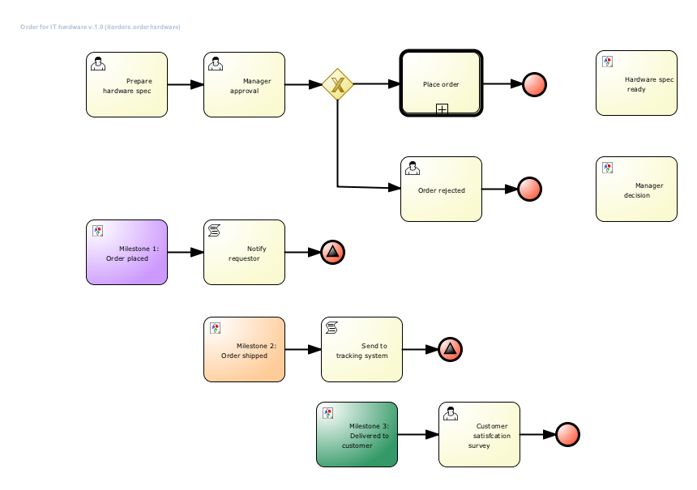
JBoss BRMS Loan Realtime Decision Server Demo
I can release without coupling releases with UI & can offer rule services to other apps
A LOT OF STRESS
www.abc
Marcketing
Customer
Customer
SEPARATING OUT
Customer
I know how to do that!! BRMS KIe Server
<number>
BRMS in Digital Transformation
DEVELOPER
Notes:
Demo 3:
In the 2010s mobiles are super cool to carry around and all the cool kids sit with their friends in fancy cafes drinking mochaccino and buying things online. The application code and the RULES are running very close together ie. in the same machine and they are sharing processing power. The rules are not receiving the appropriate CPU availability as the graphics card is working super hard to handle all the animations. Something needs to be done. David decides to separate the architecture so that rules can be run centrally in BRMS Kie Server. Lisa loves the ideas as it gives her not only to release the Business Logic outside the front-end application but also
It can make it available to other applications
It is de-coupled when it comes to deployments from the front-end.

Slide 45
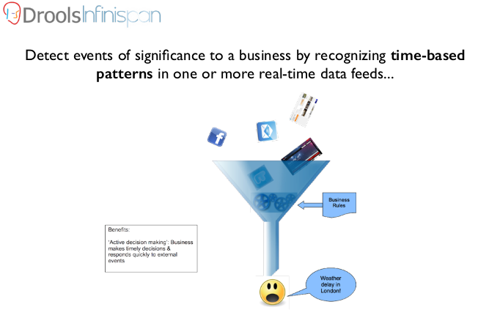
BRMS HACEP for Analysing Trends
Policy setting is disconnected from real-time input … Customers are not and expect the same behavior from the systems
When I click I expect MAGIC!!!
Customer
REDHAT has developed HACEP Ref ARchitecture
Marcketing
DEVELOPER
<number>
BRMS in Digital Transformation
Notes:
Demo 4:
We have reached 2017 and Lisa feels all these policy definitions on promotions and loans are a bit static. Could we not employ all the data we and FACEBOOK are collecting on our customers so that our decision making is dynamic and based on real time EVENTS rather than predictions of our analysts?
David thinks over the question and he replies well the good guys at Red Hat have developed a reference architecture based on BRMS CEP (in other words an Expert SYSTEM) which rather than having real people defining the policies you can utilize him to look at trends and dynamically define the rewards or loan percentage you provide to a customer based on his/her historical usage… his name is AI? Or maybe even better why not get AI to do all the work so you can spend more time in the coffee area.
why look at events in 1-Dimension when we can correlate/aggregate and abstract the purschasing habbits of our customers over time. You know what is coming …. BRMS CEP!!!

Slide 46
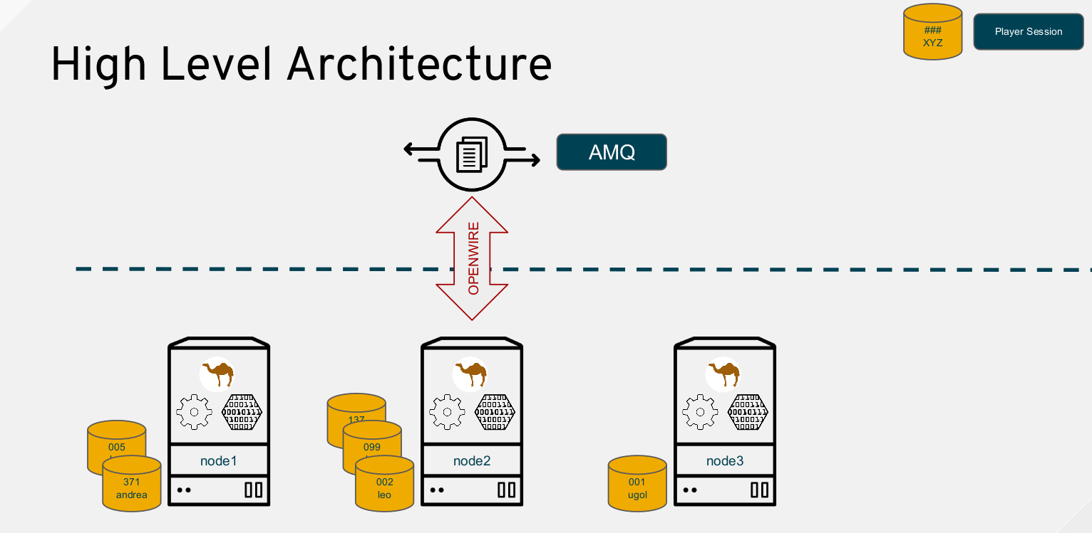
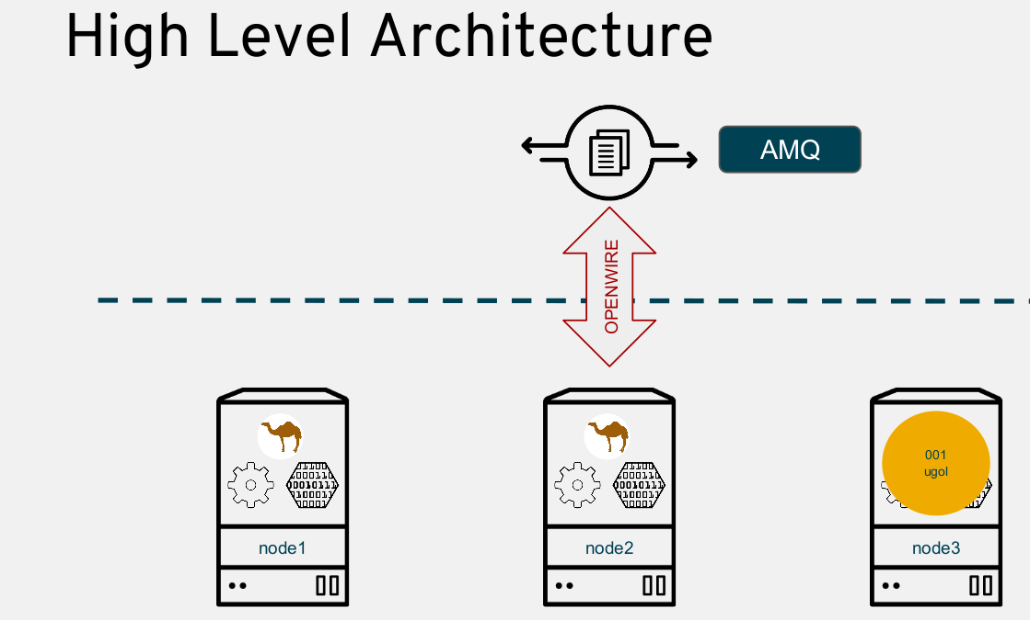
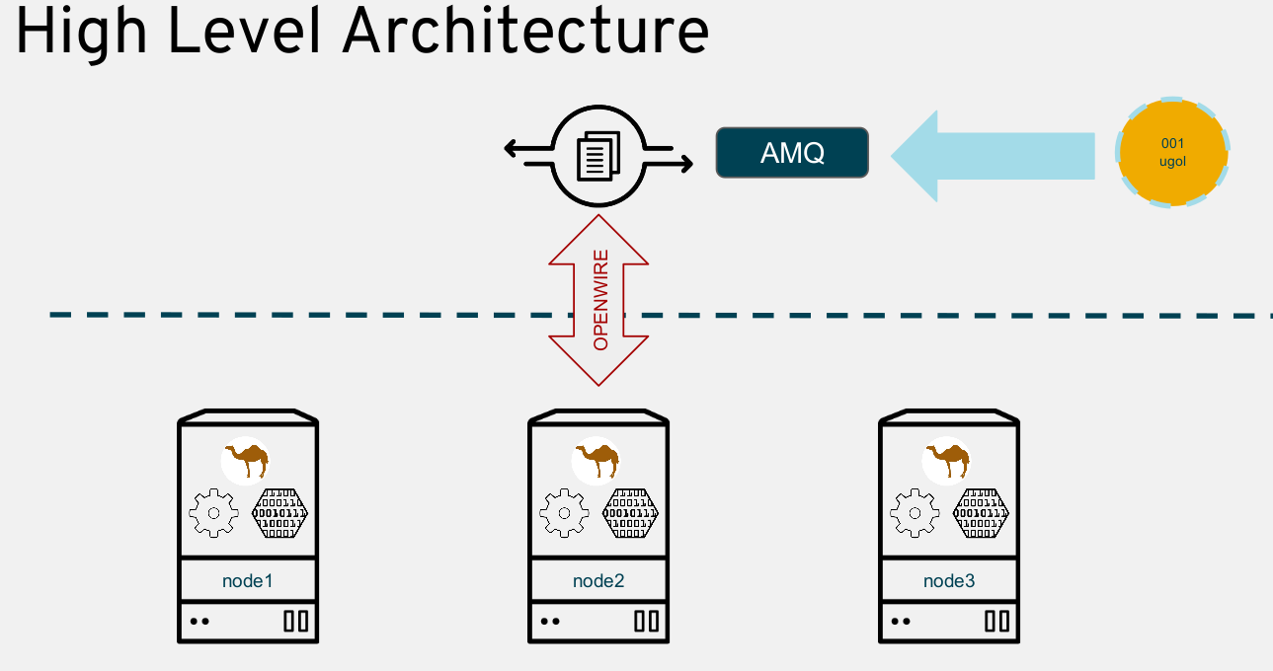
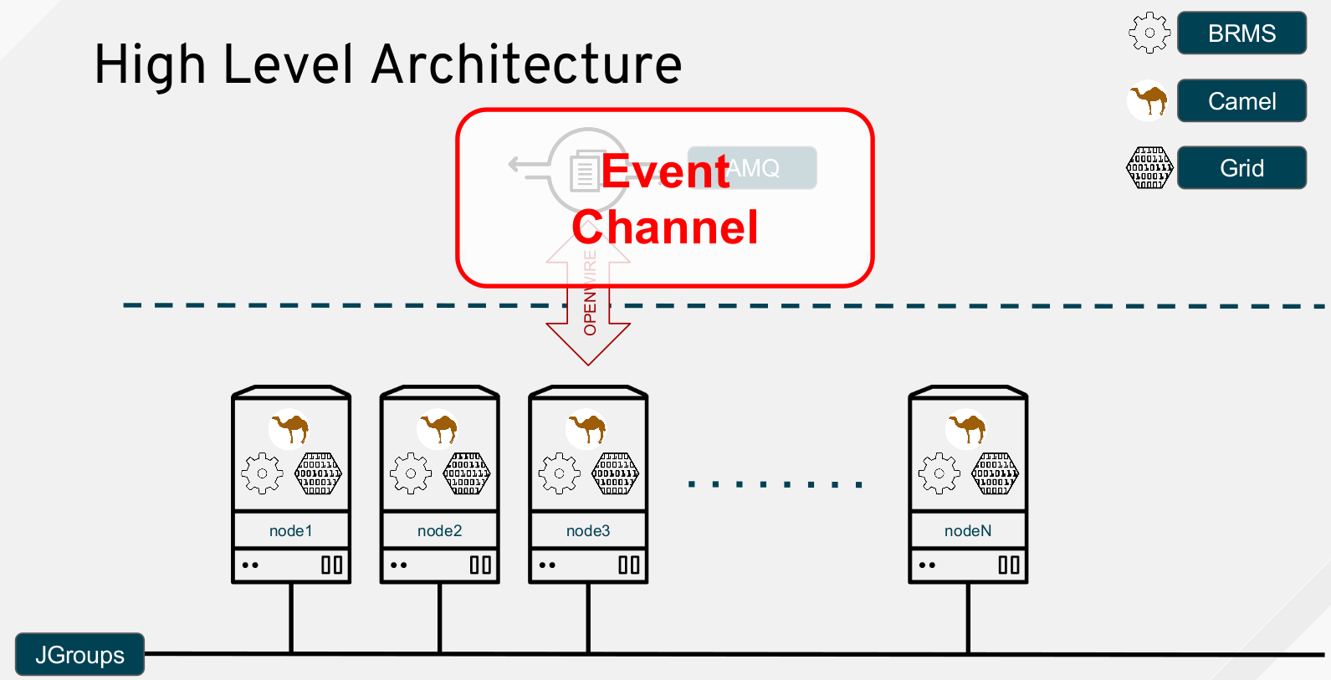
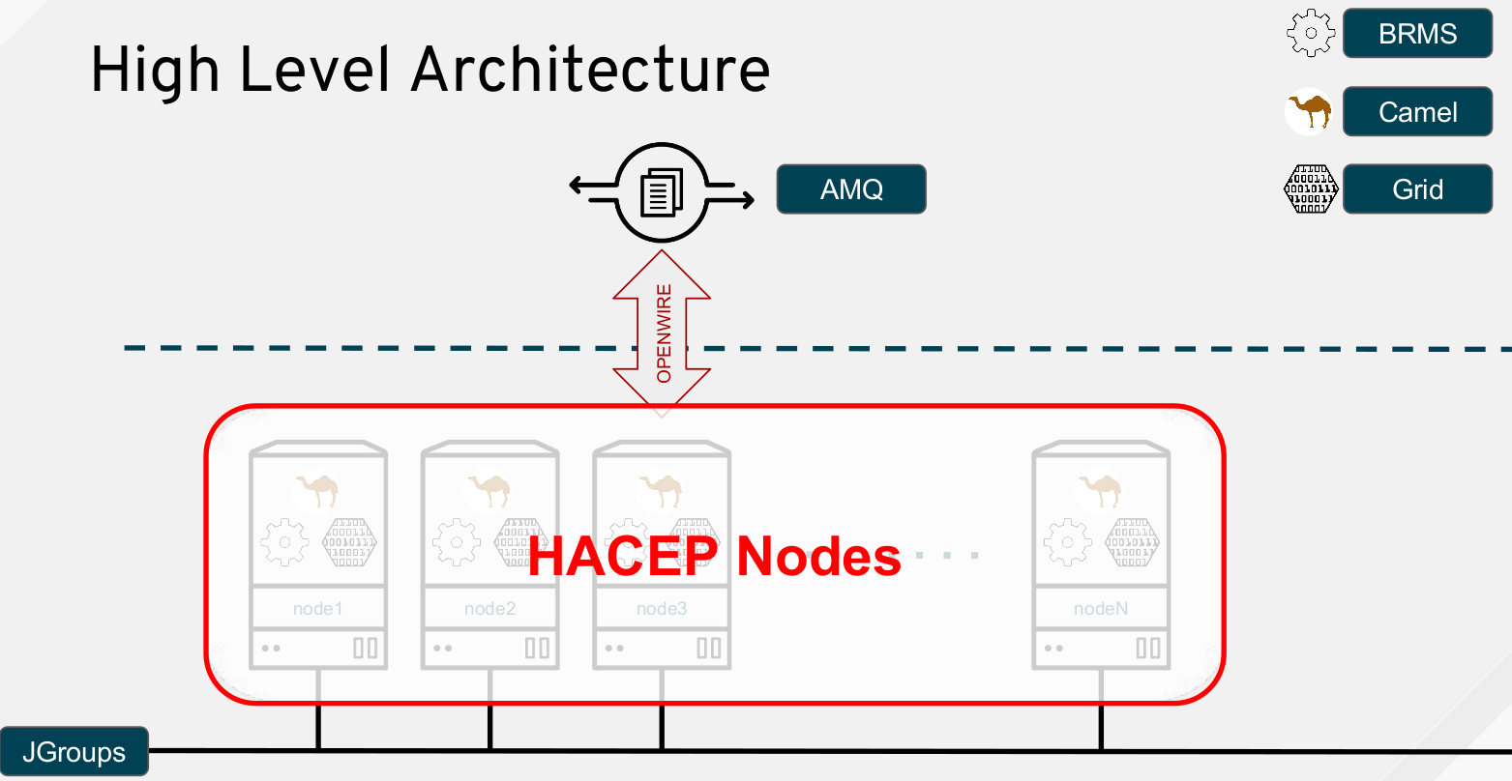
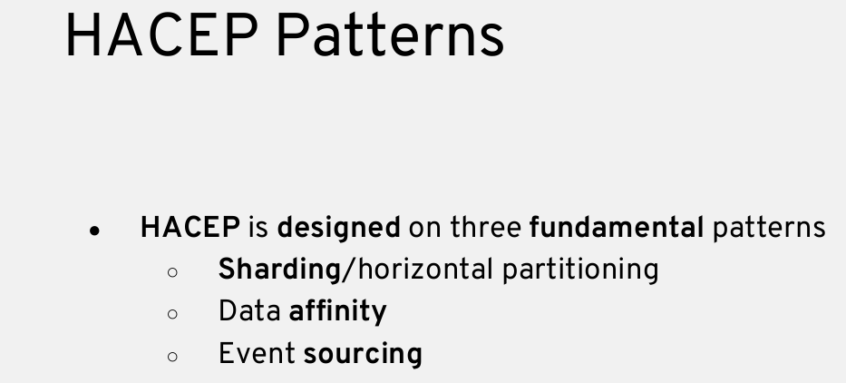
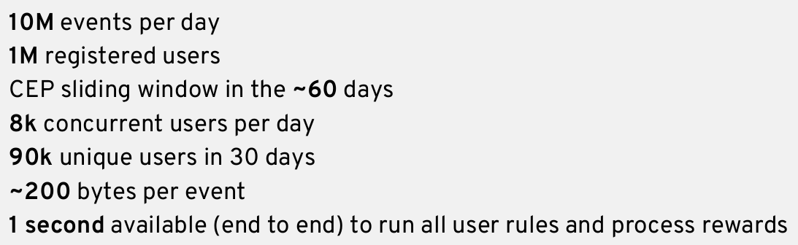
BRMS HACEP Reference Architecture
<number>
BRMS in Digital Transformation

Slide 47
Real BRMS Use Cases
Notes:
We will now review a set of real life use cases where JBoss BRMS Authoring and Runtime components were employed to assist organizations to make the leap to digital transformation.
At this point it is worth to re-emphasize that BRMS and business rules is not a technology which has a fancy user interface and it is for this reason that
Most of us have are troubled to visualize and quantify
It is for that reason that in all of the use cases they are part of an application and not a standalone solution

Slide 48
BRMS & BPM Suite Value across industries
Banking
Insurance
Capital Markets
Public Sector
Onboarding
Loan Organisation
Credit Decisioning
Accounting
Fraud Detection
Claims Processing
Quoting
Rating
Trading
Regulatory
Utilities
Transportation
Retail
Manufacturing
Order Mgmt
Network Monitoring/IoT
Recommendation (Barcelo, StartToday-ZozoTown)
Campaign Mgmt (
Pricing
Supply Line Monitoring/IoT
Delivery Planning
<number>
BRMS in Digital Transformation

Slide 49

Banking: Credit Decisioning & Loan Organization
Finanz Informatik
Finanz Informatik (FI), the central IT service provider for the German Savings Banks Finance Group, serves 122 million accounts and wishes to improve and streamline workflows
<number>
BRMS in Digital Transformation
Notes:
https://www.redhat.com/cms/managed-files/mi-finanz-informatik-business-rules-process-management-jboss-brms-case-study-f5617cw-201701-v2-en.pdf
Finanz Informatik (FI), the central IT service provider for the German Savings Banks Finance Group, is one of the largest IT service providers for the financial industry in Europe, serving 122 million accounts. Its customers include savings and federal state banks, loan associations, public insurers, and other companies within the German Savings Banks Finance Group and the financial services sector. FI provides a range of services, including development and implementation of IT solutions, networks, and technical infrastructure, as well as data processing centers, consulting, training, and support.
To improve and streamline workflows, FI implemented a centralized, rules-based management system for business processes. With help from Red Hat
Consulting, FI deployed Red Hat JBoss BRMS. With the robustness of the platform, FI has simplified management of critical business processes, reduced risk of user-related errors, and can seamlessly integrate decision logic into its business applications.

Slide 50







Banking: Credit Decisioning & Loan Organization
Legacy Solution
CHANGE
Loan Associations
CHANGE
CHANGE
CHANGE
Finanz Informatik Applications
Public Insurers
Savings Banks
Federal State Banks
CHANGE
<number>
BRMS in Digital Transformation
Notes:
https://www.redhat.com/cms/managed-files/mi-finanz-informatik-business-rules-process-management-jboss-brms-case-study-f5617cw-201701-v2-en.pdf
Previously, FI used rules-based management that directly embedded rules into its various disparate applications. Business logic was captured by analysts and developers would implement at the back of defined use cases application code which either included the logic or inferred it from the stream of data being received or available in data pools.
However, the centralized rules-based management system only offered standardized business rules.
This method resulted in high programming and testing costs and limited user flexibility. In addition, this approach made modeling sets of complex rules difficult.
To improve costs and flexibility for its customers — as well as display and define complex rules — Finanz Informatik sought a new business rules management solution.

Slide 51
Banking: Credit Decisioning & Loan Organization
Refactoring with BRMS
Public Insurers
Federal State Banks
Savings Banks
Loan Associations
Finanz Informatik Business Tools
Deliver Custom Rules Centrally
Deliver Custom Rules Centrally
<number>
BRMS in Digital Transformation
Finanz Informatik Rules Service
Notes:
https://www.redhat.com/cms/managed-files/mi-finanz-informatik-business-rules-process-management-jboss-brms-case-study-f5617cw-201701-v2-en.pdf

Slide 52
Banking: Credit Decisioning & Loan Organization
Gains
Public Insurers
Federal State Banks
Savings Banks
Loan Associations
Complex business decision logic employed
Efficient & Consistent Process management
Rules Service Based Interface to decouple business logic and enable swift changes
Rule Logic delivered in format of Excel spreadsheets, intuitive rule metaphors, such as decision tables, scorecards, or domain-specific languages
Finanz Informatik Business Tools
Deliver Custom Rules Centrally
Deliver Custom Rules Centrally
<number>
BRMS in Digital Transformation
Finanz Informatik Rules Service
Notes:
https://www.redhat.com/cms/managed-files/mi-finanz-informatik-business-rules-process-management-jboss-brms-case-study-f5617cw-201701-v2-en.pdf

Slide 53
Banking: Anti Money Laundering Detection
AML is practice of integrating the proceeds of crime into the legitimate mainstream of the financial community by concealing its origin.
Team Good Guy:
Financial institutions,
Regulators and
law enforcement
In 1920;s, Gangsters had money in small denominations. They started business of slot machines and laundromats. Thus the term laundering.
<number>
BRMS in Digital Transformation

Slide 54
Banking: Anti Money Laundering Detection
AML Approach
SANITIZE
&
ORGANIZE DATA
ANALYZE DATA
POST CLASSIFICATION
TASKS
<number>
BRMS in Digital Transformation
Notes:
LISTEN TO RECORDING FROM SUMMIT AND KEEP NOTES
AML is practice of integrating the proceeds of crime into the legitimate mainstream of the financial community by concealing its origin.
Team Good Guy:
Financial institutions, Regulators and law enforcement
In 1920;s, Gangsters had money in small denominations. They started business of slot machines and laundromats. Thus the term laundering.

Slide 55
Banking: Anti Money Laundering Detection
Domain Profiles with BRMS
CLASSIFY
LEVEL OF
FRAUD
&
TAKE ACTION
COLLATE DATA
CREATE PROFILES FROM
DATA
<number>
BRMS in Digital Transformation
Notes:
LISTEN TO RECORDING FROM SUMMIT AND KEEP NOTES

Slide 56
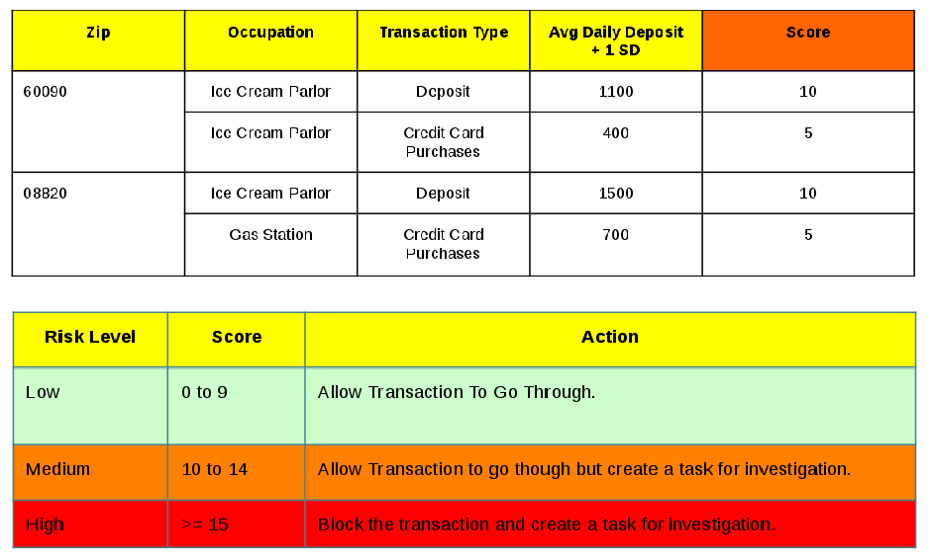
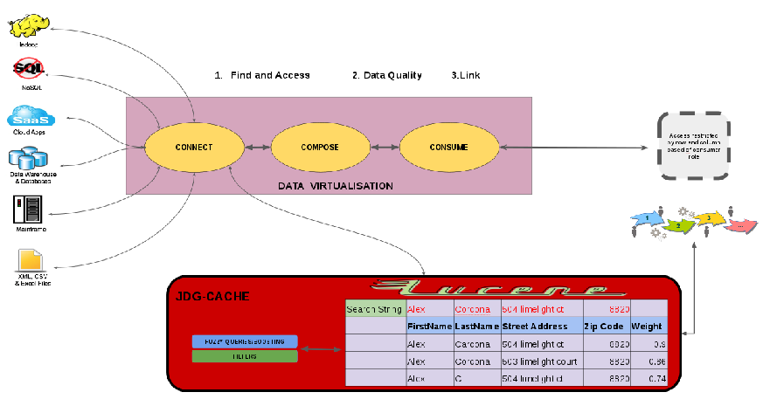
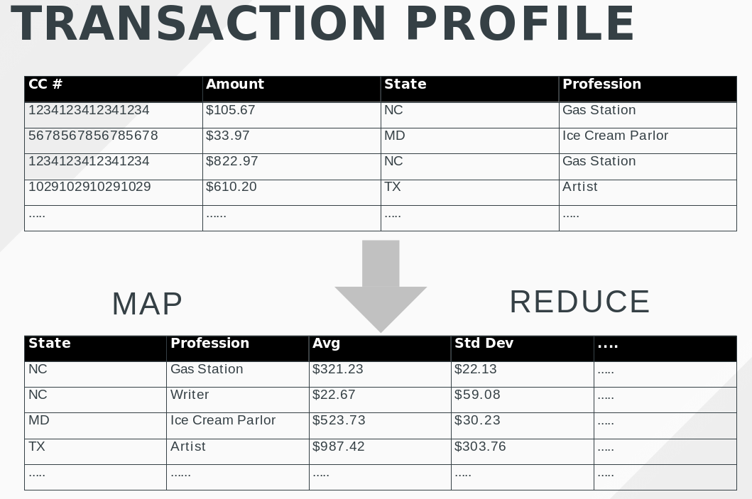

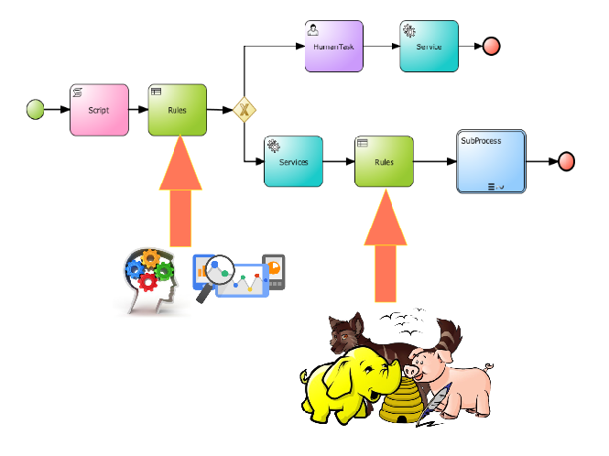
Banking: Anti Money Laundering Detection
Building Adaptive Systems with BRMS
SAP
Rules
SQL
MAP
REDUCE
FILE
REGRESS Profile Classification Rules
Analyst
Data Storage
<number>
BRMS in Digital Transformation
Notes:
BUILD AN ADAPTIVE SYSTEM
BUILD SMARTER RULES USING STATIC, LINEAR REGRESSION AND SOCIAL GRAPH INPUTS

Slide 57
Banking: Credit Decisioning & Loan Organization
Problem Domain
An inconsistent worldwide process with absent transparent criteria of onboarding customers and delivering timely response to credit requests. Monitoring and alerting based on manual labor of recording task initiation and resolution.
<number>
BRMS in Digital Transformation

Slide 58
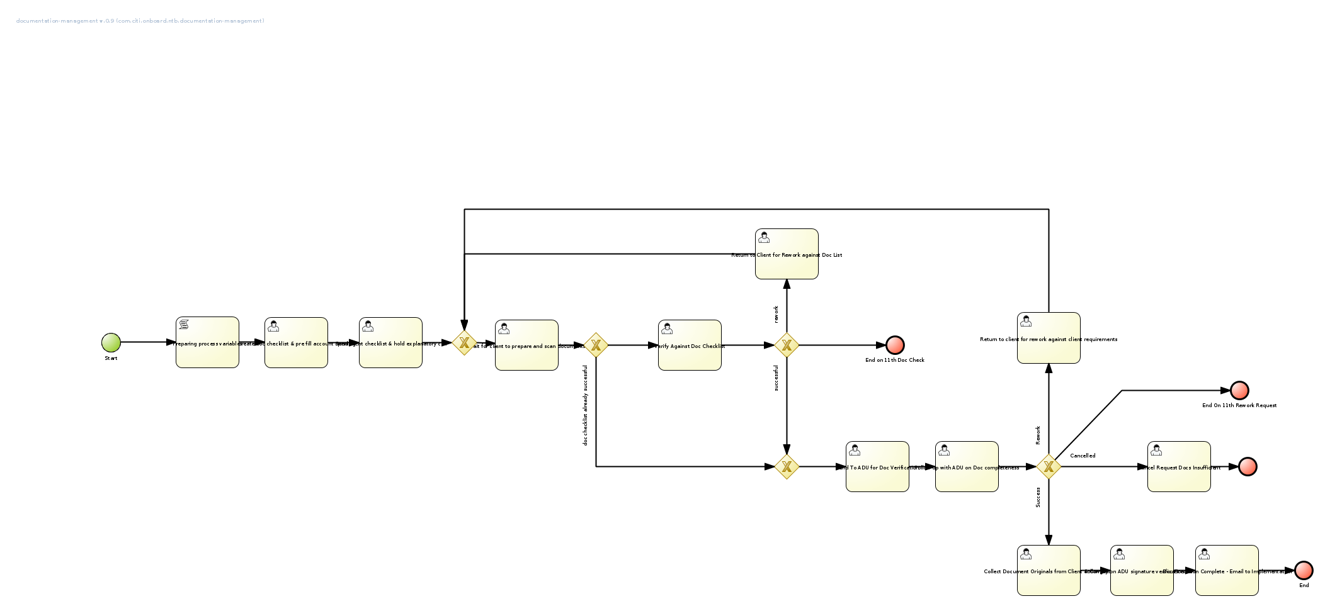
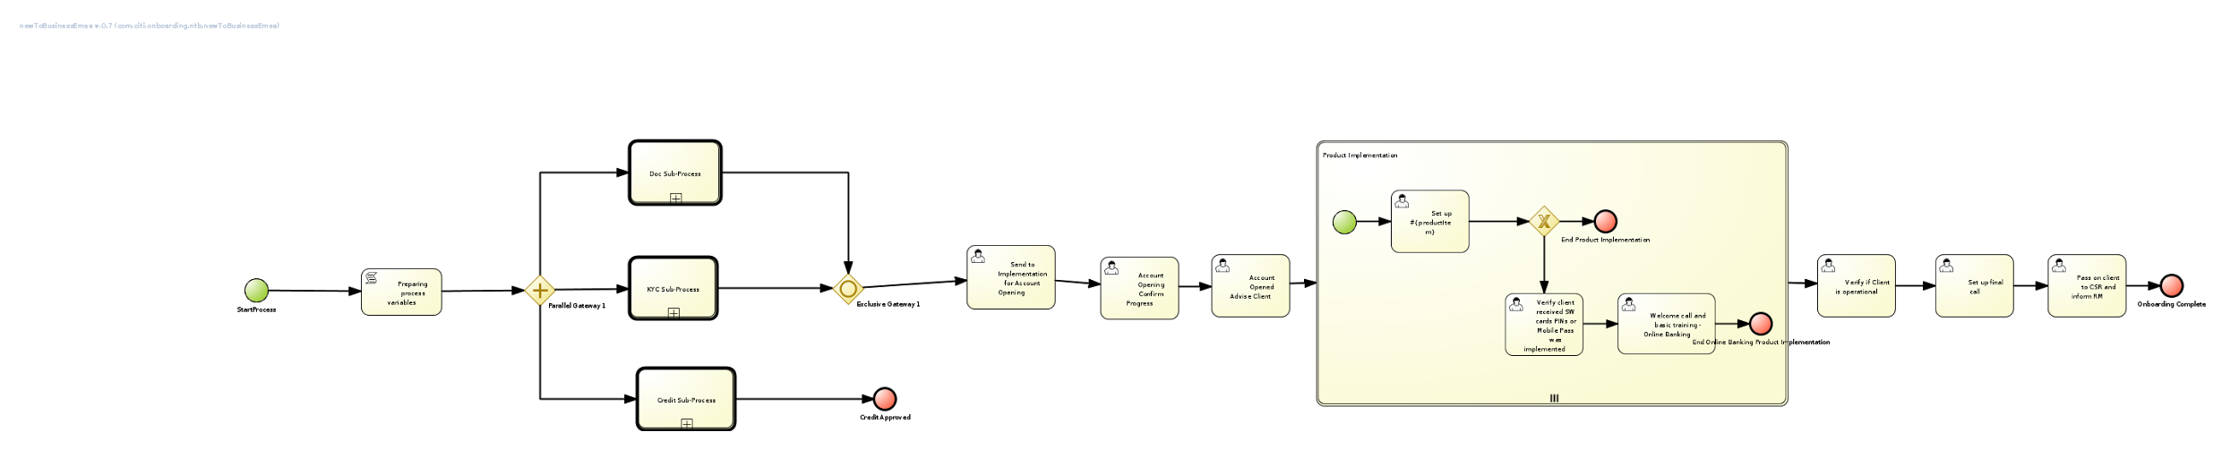
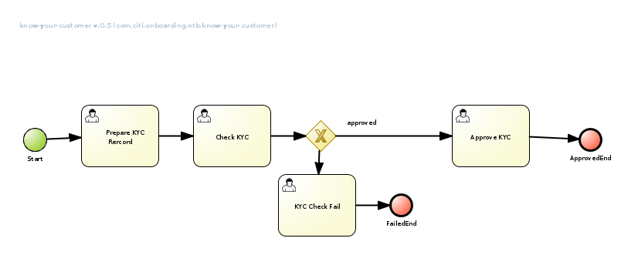
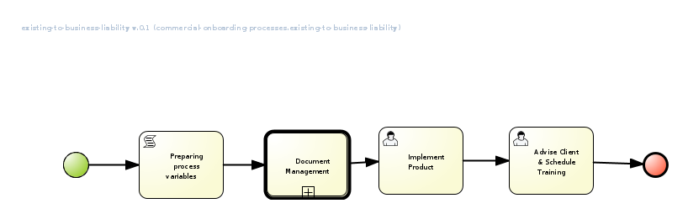
Banking: Credit Decisioning & Loan Organization
Case Officer
Record Time in/out in Excel. Difference > threshold Reviewed by supervisor
Manual Review > 1m
Acc. Manager
Manual Review Docs, Data
Progress Data processed & Alert created > threshold
Case. Manager
<number>
BRMS in Digital Transformation

Slide 59
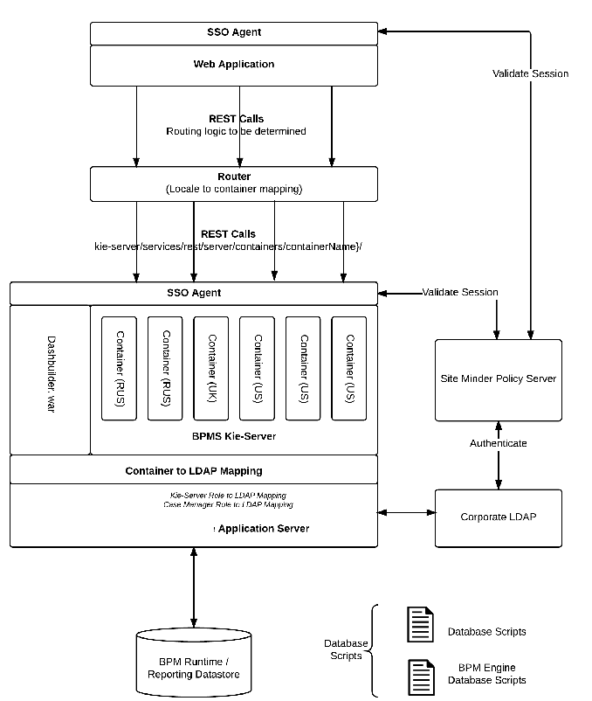
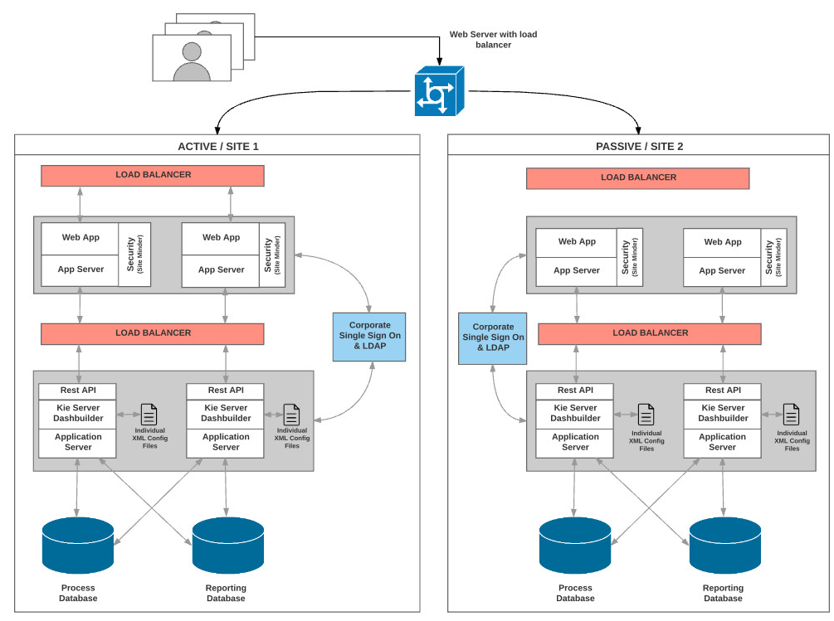
Banking: Credit Decisioning & Loan Organization
Architecture Employed
<number>
BRMS in Digital Transformation

Slide 60
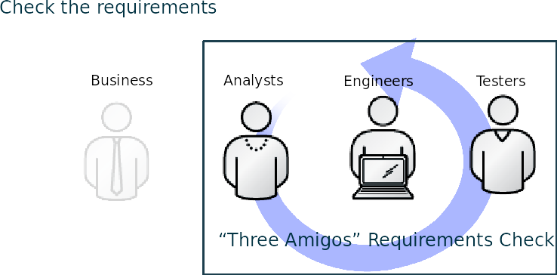
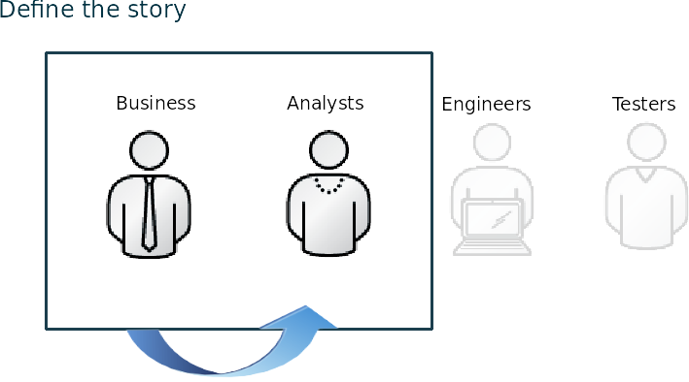




Banking: Credit Decisioning & Loan Organization
Adjust for Business Driven Delivery
User Stories
Guided Tables, Excel Sheets
Acceptance Criteria Driven Development
<number>
BRMS in Digital Transformation

Slide 61
Banking: Credit Decisioning & Loan Organization
Gains
Onboarding process reduced to 2-3 weeks on average
Consistent workflows and business decisions reduced manual steps by 70-90%
Subject matter expert time to focus on case content increased by 50-70%
Red Hat is now in Phase 4 of the project delivering both UI & backend services, infrastructure with the customer having been employed only to assit delivering a minimal viable product.
<number>
BRMS in Digital Transformation

Slide 62



Insurance: Quoting
RSA
Customer
www.rsa
BUSINESS CHALLENGE
Customer receives efficient, competitive, and comprehensive services when visiting the RSA eChoice website.
RSA eBusiness team has the capability to modify business rules in a timely fashion.
Define package promotion rules
And
Quoting rules
RSA Analyst
House insurance package
Health insurance package
Loan insurance package
Car insurance package
<number>
BRMS in Digital Transformation
Notes:
https://www.redhat.com/en/files/resources/en-rhjb-rsa-improves-agility-brms-9455997.pdf

Slide 63
Insurance: Fraud Detection
BUSINESS CHALLENGE
Provide a Fraud Scoring platform for batch processing of up to 3.5 billion claims daily in under 60 minutes
Provide standard federated rules
Allow sub-division to inherit and expand rule base
Business Users without technical knowledge to define and test rules
Reduce 6-12 weeks business logic update cycles
<number>
BRMS in Digital Transformation

Slide 64
Insurance: Fraud Detection
Authoring Federated & Division Rules
Division
Fraud Analyst
Runtime Environment (one per division)
Central Rules Repository
Business Central
Business Central
Release
New
Rules
Tool for
business experts
Division
Rules Project
Batch Fraud Scoring
Load Data
RULES
Claims
Core Fraud Analyst
Testing Rules
Testing Rules
Processed 1.5-3.5 billion claims in 35 minutes for fraud scoring (11% spent on rule execution and bulk on data provisioning)
Reduced upto 80% maintenance of fraud scoring rules per division
Eliminated division cost to run software to perform scoring
Reduced 6-12 weeks TTM down to 1-3 days
Informed of claims > threshold
Tools for developers
Technical Rule Developer
Results
Fraud Officer
<number>
<number>
BRMS in Digital Transformation
BRMS in Digital Transformation

Slide 65


Capital Markets: Trading Platform
Problem Domain
Legacy Trading Platform
A trading platform built on highly available Status hardware.
Expensive to maintain
Required dedicated staff with specialized skills
Cumbersome to expand and update.
New Trading Platform Vision
Modular
Simple/Efficient horizontal scalability as throughput increases.
Adaptable to accept trades from disparate trading interfaces, perform trade order and execution processing and send out to a variety of equities and options exchanges.
Trade data is validated, processed, transformed, enriched, cached, routed, and transmitted.
Strict SLAs for uptime(99.9999% uptime required during trading hours), throughput, latency, fault tolerance(tolerate single node failure without breaking latency or throughput), disaster recovery(geographic replication, with a switchover of 5 minutes or less), and scalability.
Throughput of 200 messages per second, and up to 900,000 executions per day, with a maximum processing time of 200 milliseconds per layer, and 1 second end-to-end.
<number>
BRMS in Digital Transformation

Slide 66




Capital Markets: Trading Platform
Platform Rules Focus
Stream 1
Trade Requests
Trading Policies & Validations
Trade Policy
BRMS
Stock Market 1
BRMS
Stream 2
Trade Policy
Stock Market 2
Trading Policies & Validations
BRMS
BRMS
Stream N
Trade Policy
Trading Policies & Validations
BRMS
Otions
BRMS
CEP (Time/SIze) Trades Analysis
BRMS
<number>
BRMS in Digital Transformation

Slide 67







Public Sector: Regulatory
Regulations in BRMS
Building a 2 story house in city centre
Cutting a Tree in Town
Cutting a tree next to a river & < 500m from a provincial road
Building a house next to a river
<number>
BRMS in Digital Transformation

Slide 68

Decision Model & Notation
DRD
<number>
BRMS in Digital Transformation

Slide 69

Decision Model & Notation
Decision Table
<number>

Slide 70

Utility: Energy Sensor Monitoring
Problem Domain
Improved UX for (business users)
Wish to take advantage of IoT capabilities of energy meters
Monitoring of sensors with diverse capabilities
Meter faults
Meter readings
Meter tampering
Energy surges
<number>
BRMS in Digital Transformation

Slide 71






Utility: Energy Sensor Monitoring
Problem Domain
Repair/Replace
Fault Stream
Channel A
Validations
BRMS
Produce Bill
Pass Event to Stream
Channel B
Reading Stream
Increase Capacity
Capture Event
Calculating, Capacity
Channel C
BRMS
Fraud Stream
Policies
Channel D
BRMS
Load Session
D
Data Grid
D
Data Grid
D
Fault
Fault
Data Grid
Fault
CEP Session
Reading
Fraud
CEP Session
CEP Session
<number>
BRMS in Digital Transformation

Slide 72



Utility: OIL Trading
Resource Allocation Calculation
Need to send 200M gallons. of OIL Whic one will get faster?
Hard & Soft Constraints
Algorithm to assign oil tanker
Distance
Capacity
Speed
Empty/Full
BRMS
OIL Dealer
Distance
Capacity
Speed
Empty/Full
Distance
Capacity
Speed
Empty/Full
<number>
BRMS in Digital Transformation

Slide 73


Manufacturing: Supply Line Monitoring
Asahi Tekko Ironworks
Automobile parts supplier mainly for TOYOTA group
Annual sales : 140M US$
Number of employees: 480
<number>
BRMS in Digital Transformation

Slide 74











Manufacturing: Supply Line Monitoring
Problem & Solution with BRMS
<number>
BRMS in Digital Transformation
Notes:
Where Cycle Time is: The period required to complete one piece of production

Slide 75
Manufacturing: Supply Line Monitoring
Video
https://www3.nhk.or.jp/nhkworld/en/news/editors/2/ahackforproductivity/
<number>
BRMS in Digital Transformation
Notes:
Where Cycle Time is: The period required to complete one piece of production

Slide 76
Questions?
Notes:
We will now give an overview of the JBoss BPMSuite.
We will start by looking into some more specific problem areas of business automation. Specifically we look at the following business challenges:
Changing policies and rules: Rules and policies are constantly changing in any industry. Companies are expected to quickly and correctly implement these new rules and policies in their processes and automated systems.
Complex Events: the amount of events that are coming into an organisation is constantly increasing. Where 20 years ago, the only events coming into an organisation and its processes would be from the internal employees and maybe a website, we now see events coming in from mobile devices, e-mail, social media, etc. All these events can start (or more general: influence) business processes.
Processes: as already outlined in our previous section, implicit and manual processes are hard to manage wrt visibility, agility and consistency.

Slide 77
THANK YOU
plus.google.com/+RedHat
facebook.com/redhatinc
linkedin.com/company/red-hat
twitter.com/RedHatNews
youtube.com/user/RedHatVideos

